Slide 1
COVID-19 Statistics
29-07-2020

Slide 2
Latest Statistics
(updated 29-07-2020)
Total confirmed cases worldwide: 17,028,434
289,149 new cases (1% increase)
Total fatal cases worldwide: 666,996
6,621 new fatalities (1% increase)
Israel recorded 68,299 cases in total
increased by 2,006 cases (3% increase)
34.0# in confirmed cases, 56.0# in mortality
20.0# in cases per capita, 57.0# in mortality rate

Slide 3
Latest Statistics
(updated 29-07-2020)
Worldwide mortality rate: 3.9% (-0.0%)
Israel mortality rate: 0.7% (-0.0%)
US has most cases in total (4,426,982)
US has most fatal cases in total (US)
US recorded the most new cases (70,776)
Brazil recorded the most new fatal cases (1,595)

Slide 4
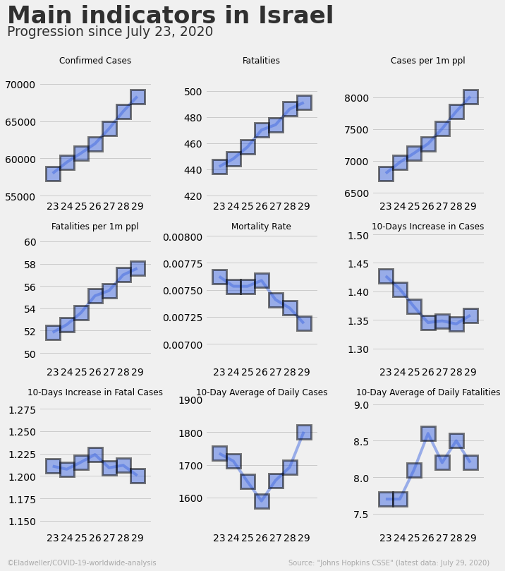

Slide 5
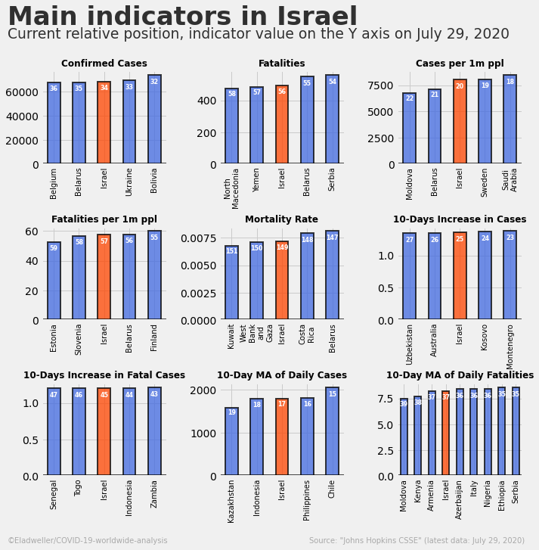

Slide 6
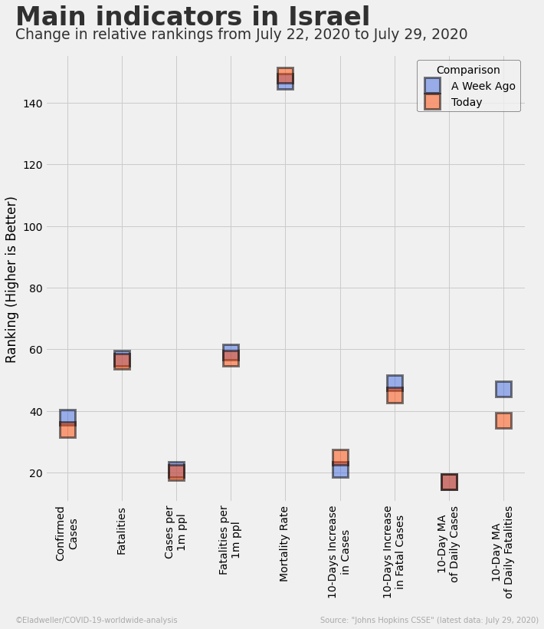

Slide 7
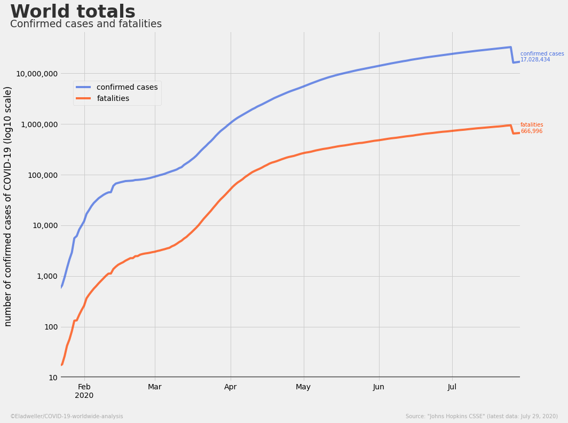

Slide 8
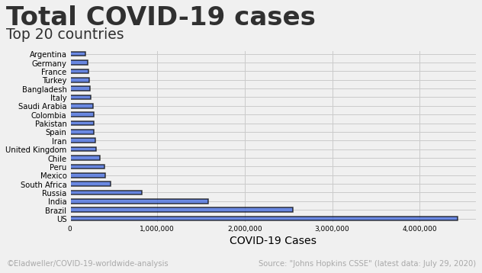

Slide 9
